Slide 1
Team 4
CSYE6200: Concepts Of Object-Oriented Programming​
Project Title: ​Online Store
Swamy Mudiga
Uday Shankar Gattu
Nishant Gada
Nirmit Rajkumar Shah
Zhe Lin
Sachin Vishaul Baskar
Surjith Senthil Kumar
Deepakraja Rajendran
Sai Srujan Penta

Slide 2
Overview
Problem Statement and Requirements
Flow and Entities Diagram
Tech Stack
Implementation and Methodology
Project Output
Learning Outcomes
Future Enhancements
Individual Contributions

Slide 3
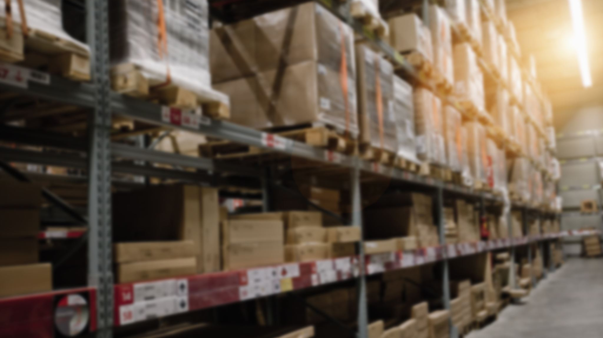
Problem Statement and Requirements
The main objective is to develop an e-commerce application for a company with which they can sell their products online.
Adding and updating products as a retailer.
Tracking and maintaining the stocks as a retailer.
Registering as a new customer and placing orders from the retailer.
Placing orders as a customer and tracking the order status.
Accepting orders as a logistics domain.
Updating the order status while in logistics.
Tracking all entities through CSV files.
Implementing Object Oriented Principles.
Implementing the models with the GUI using different entities.
Implementation of MVC design pattern.

Slide 4
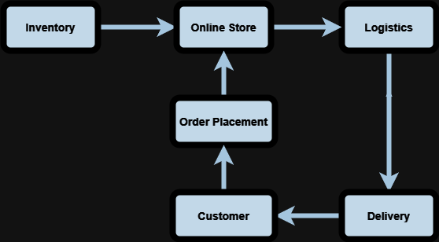
Flow Diagram

Slide 5
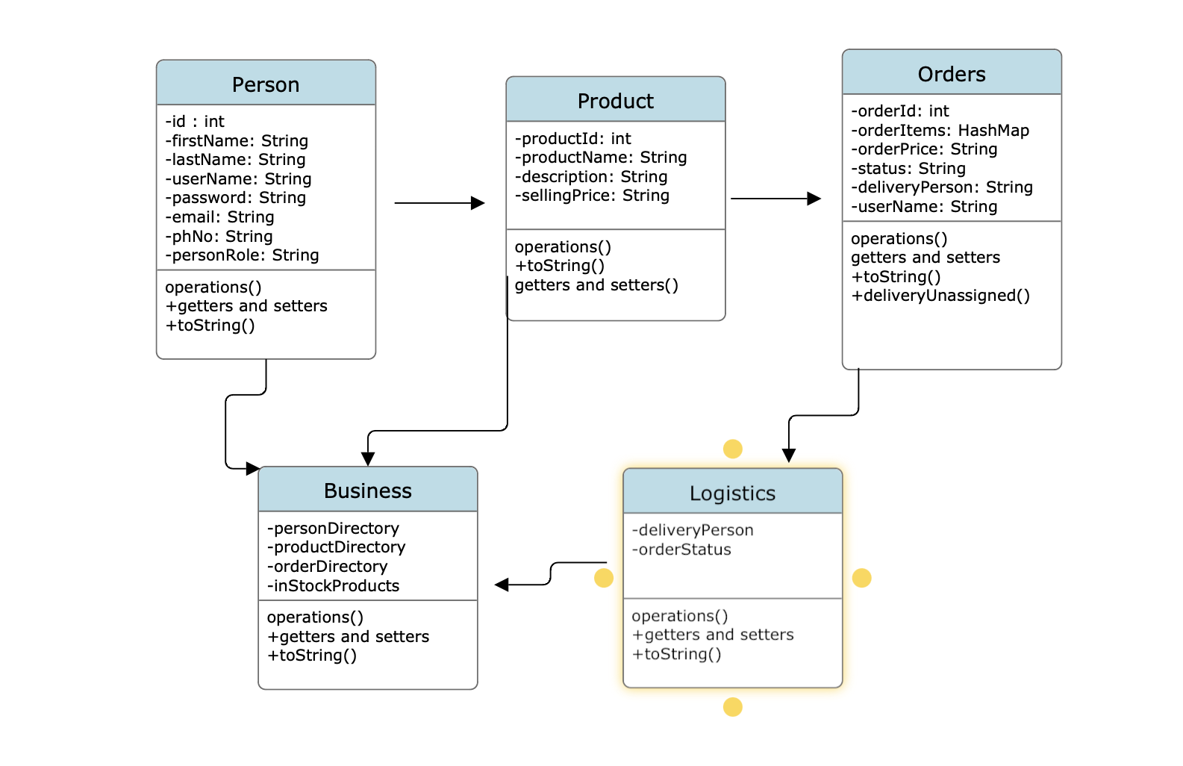
Entity Diagram

Slide 6


Techstack
Programming languages: Java.
Tools: Eclipse IDE, NetBeans, IntelliJ Idea and Github.
Front-end: Java Swing.
Data storage: CSV files.

Slide 7

Implementation and Methodology
The project’s structure is mainly concentrated on developing using MVC pattern.
In Models, the classes for Person, Customer, Retailer, Logistics, Products and Orders were created.
In Views, the main GUI components are built using Java Swing.
The Controller represents the object storing components such as Array lists and Hash maps, These controller classes can be used for developing API’s when moving into a database. .
The GUI part shows the Login and registration page, and different pages based on the role of the user such as Retailer, Customer or Logistics.
The products and their details are seeded to the application through CSV files by using the file handling operations and functionalities in java and This is defined in a separate Utils package.
The detailed website is created for all the Daycare activity tracking using JavaSwing with Spring Boot has back-end element and different threading elements are also implemented.
Objects from CSV:
Products: Inventory maintained in a separate CSV
Stocks: Stocks maintained in a separate CSV

Slide 8
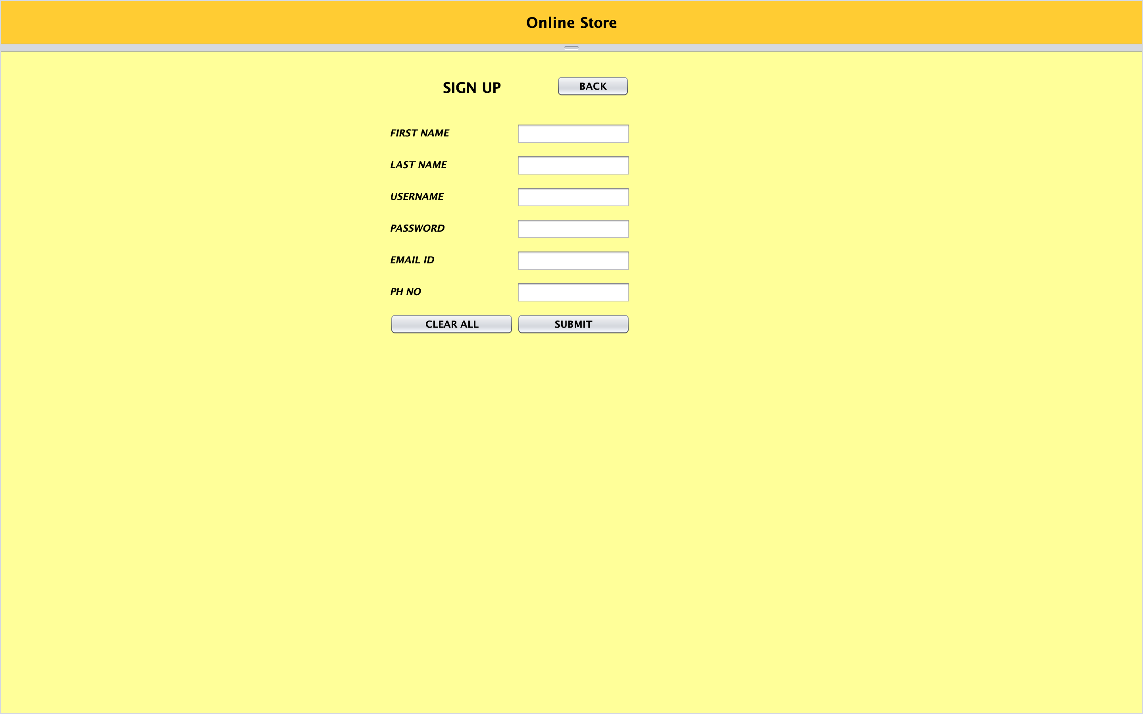
Registration Page:

Slide 9
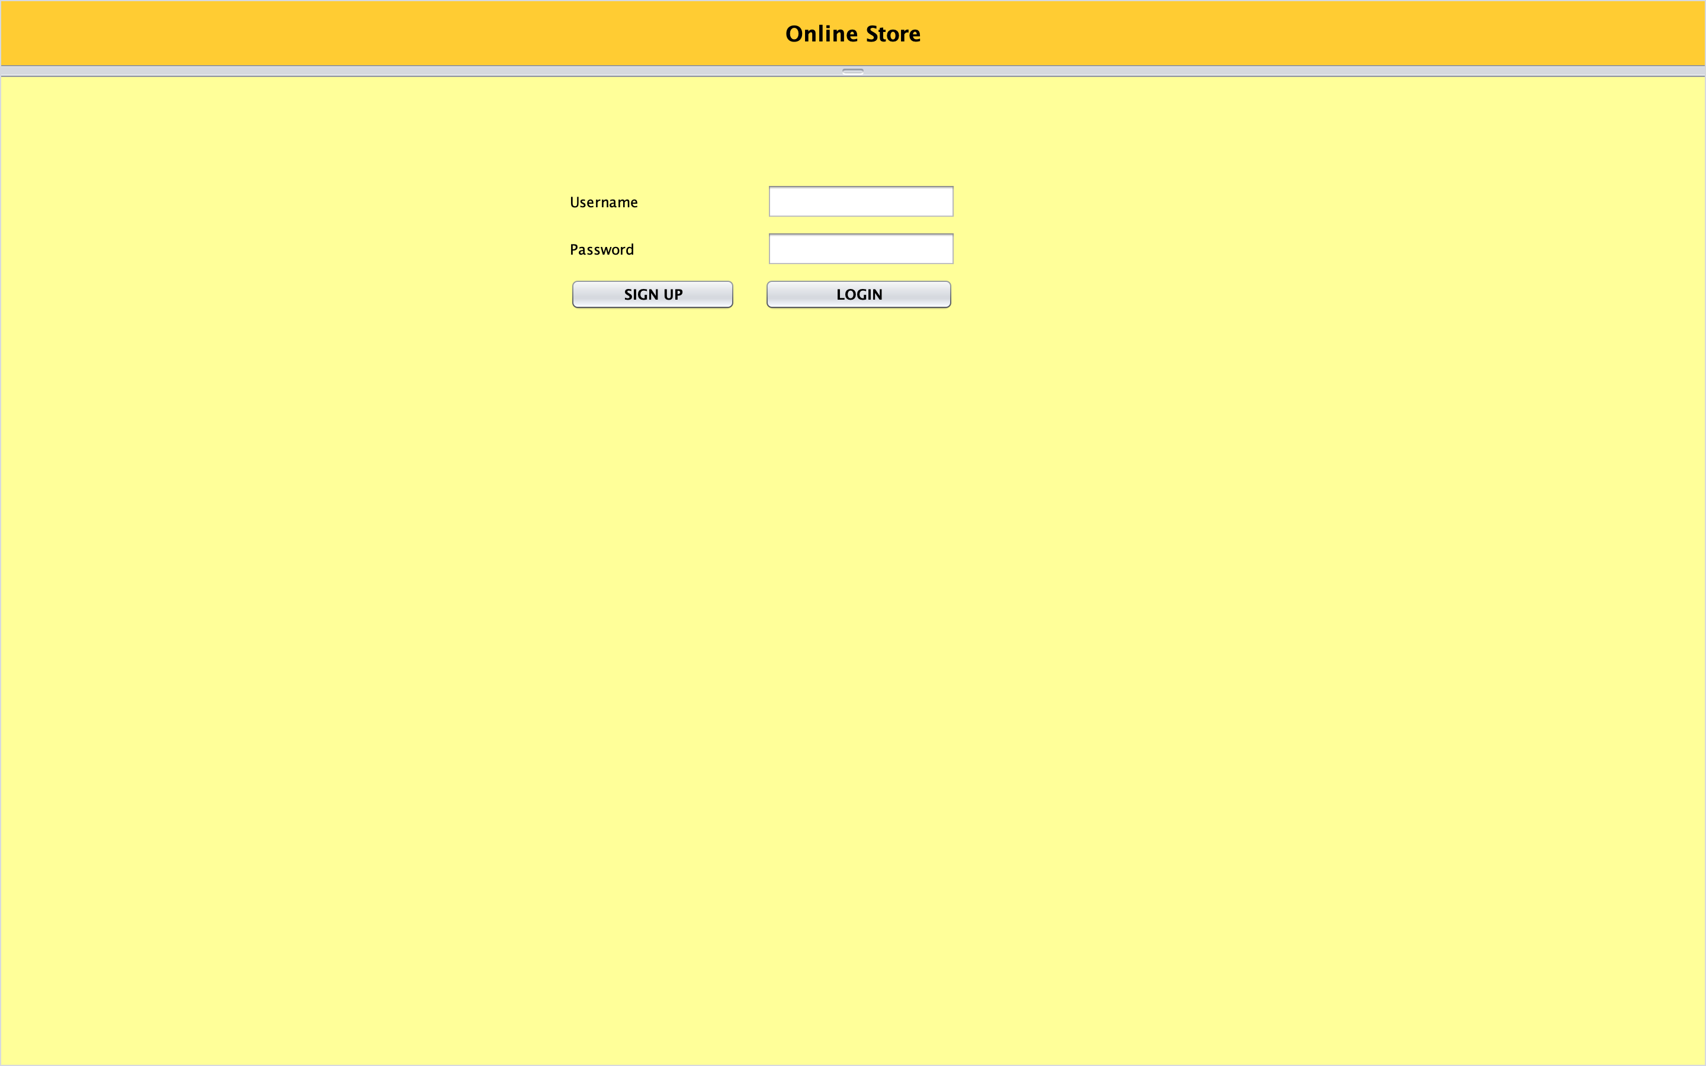
Login Page:

Slide 10
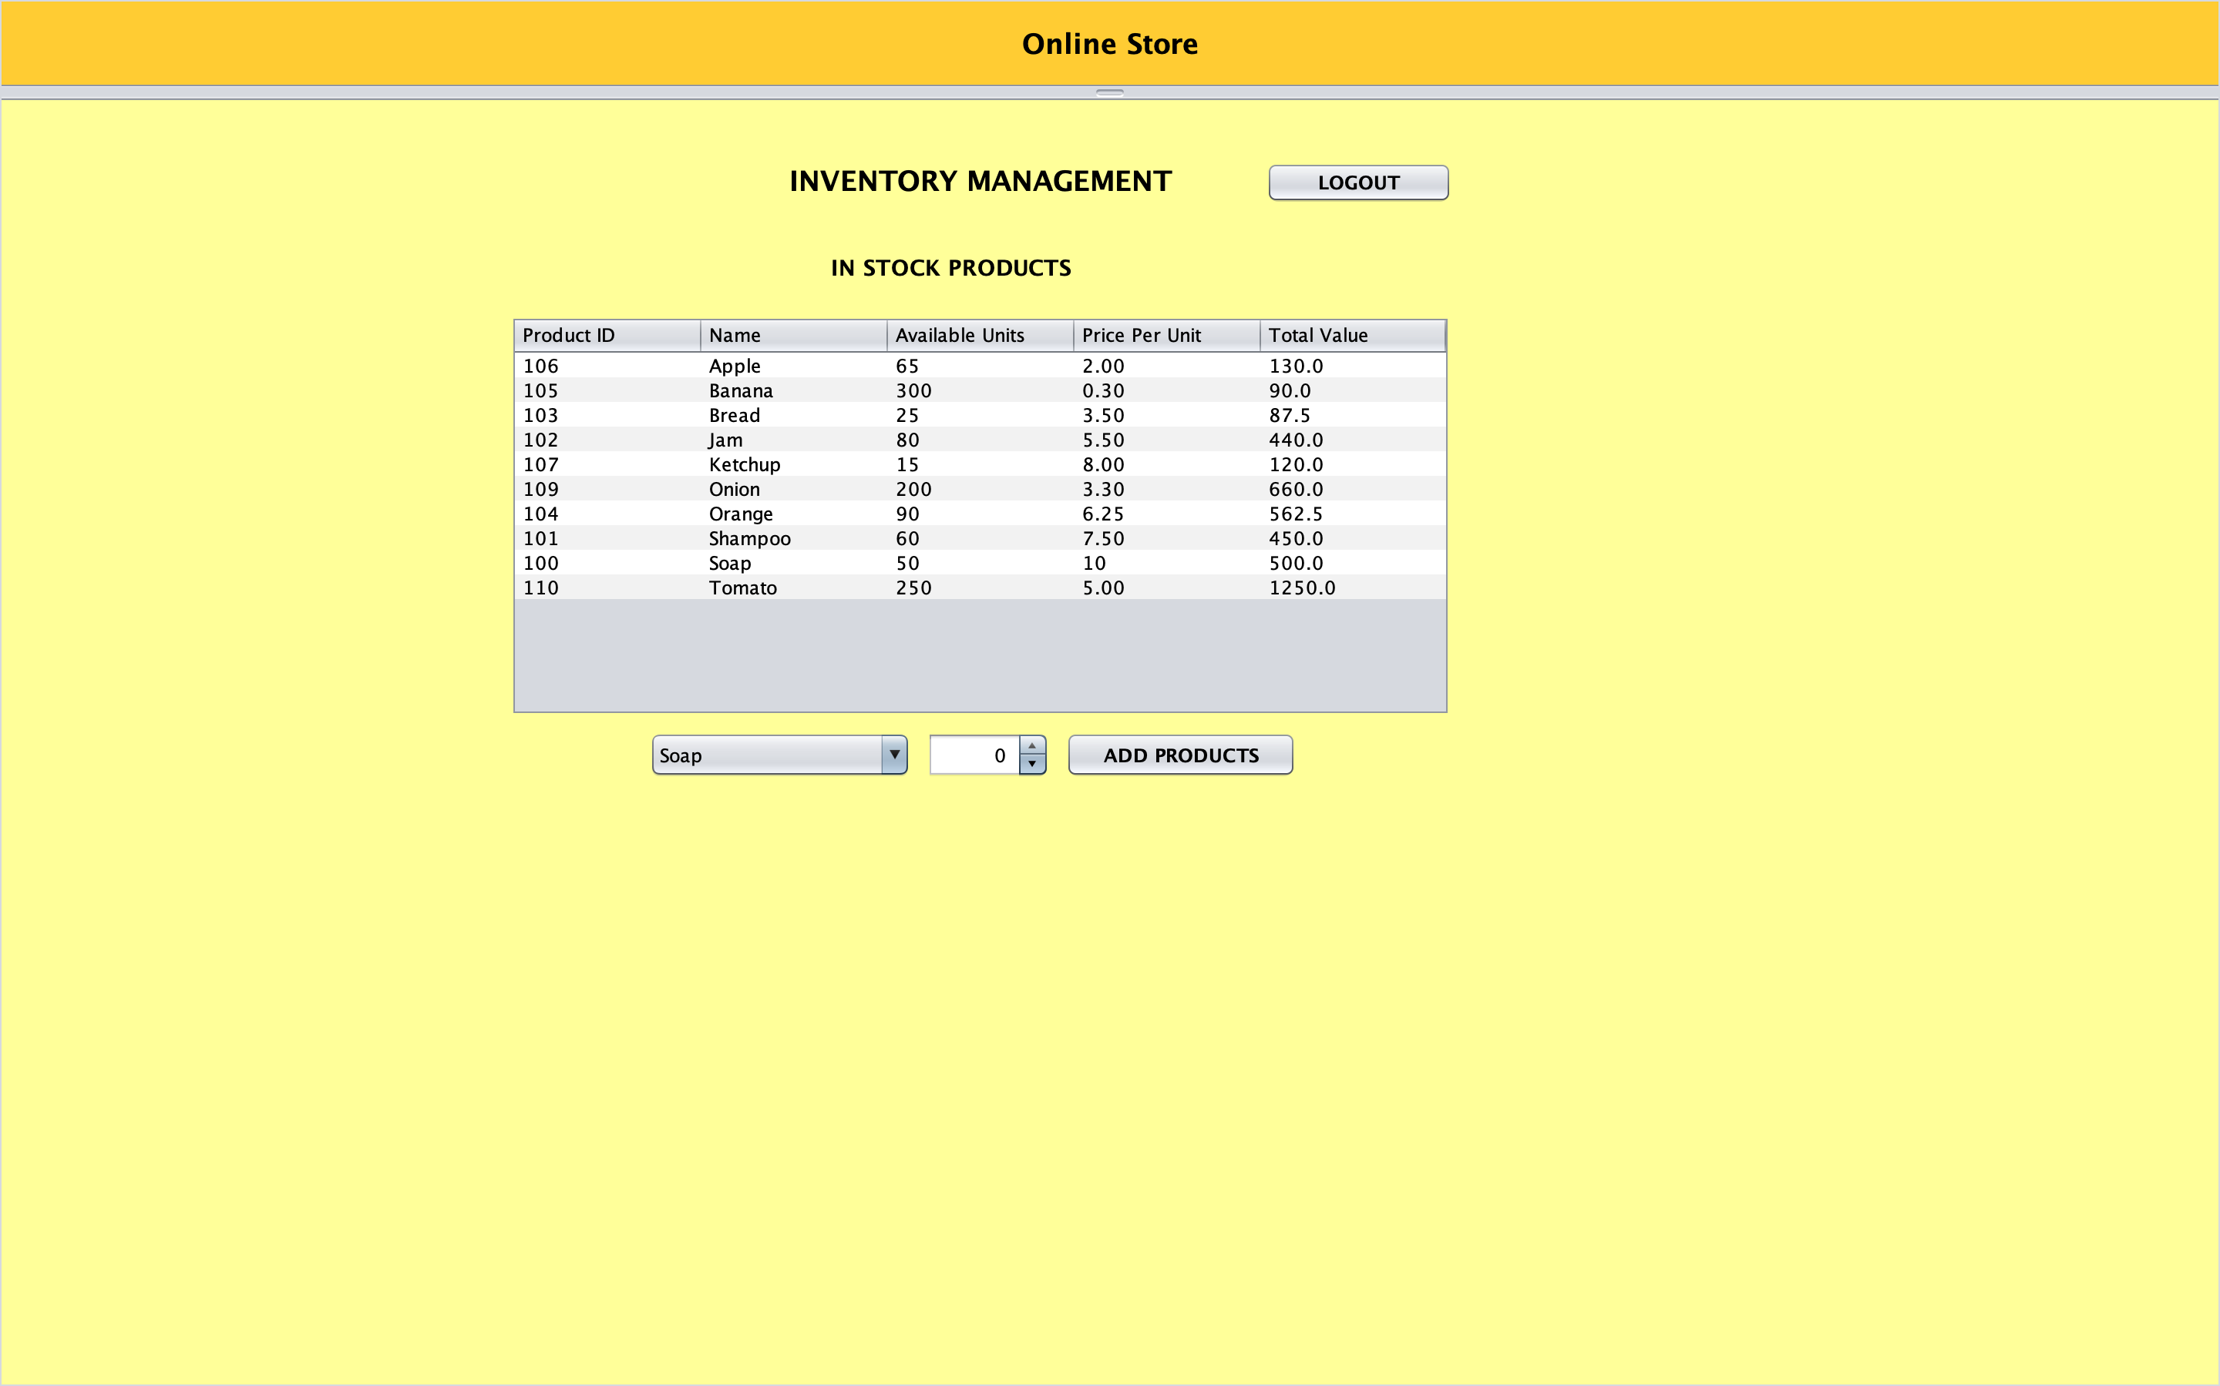
Retailer UI:

Slide 11
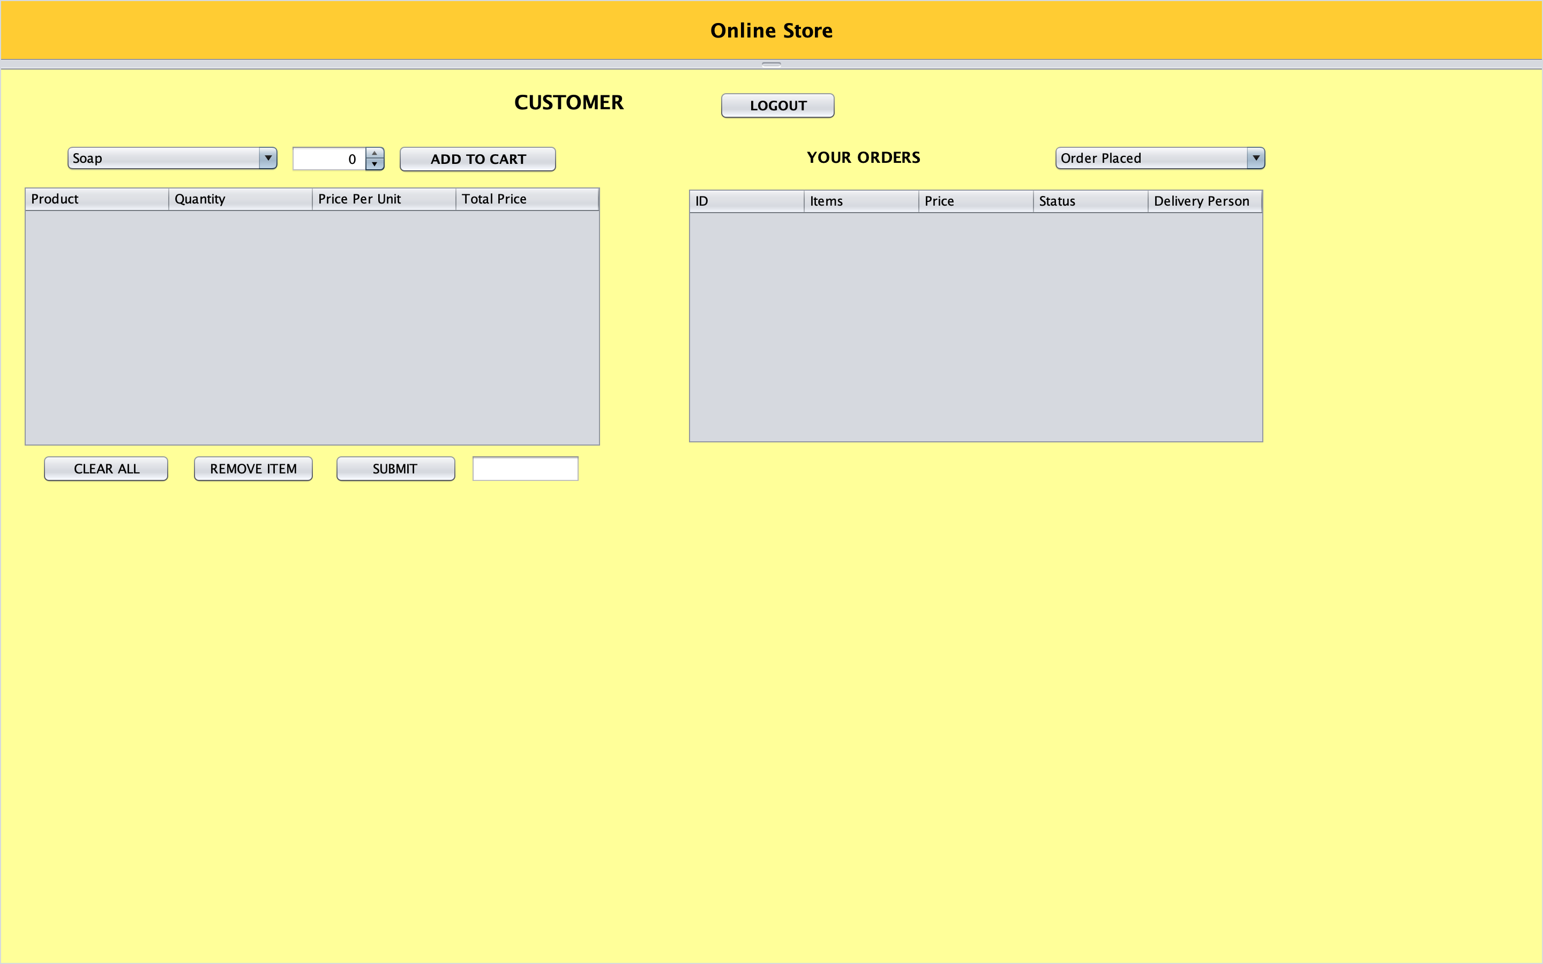
Customer UI:

Slide 12
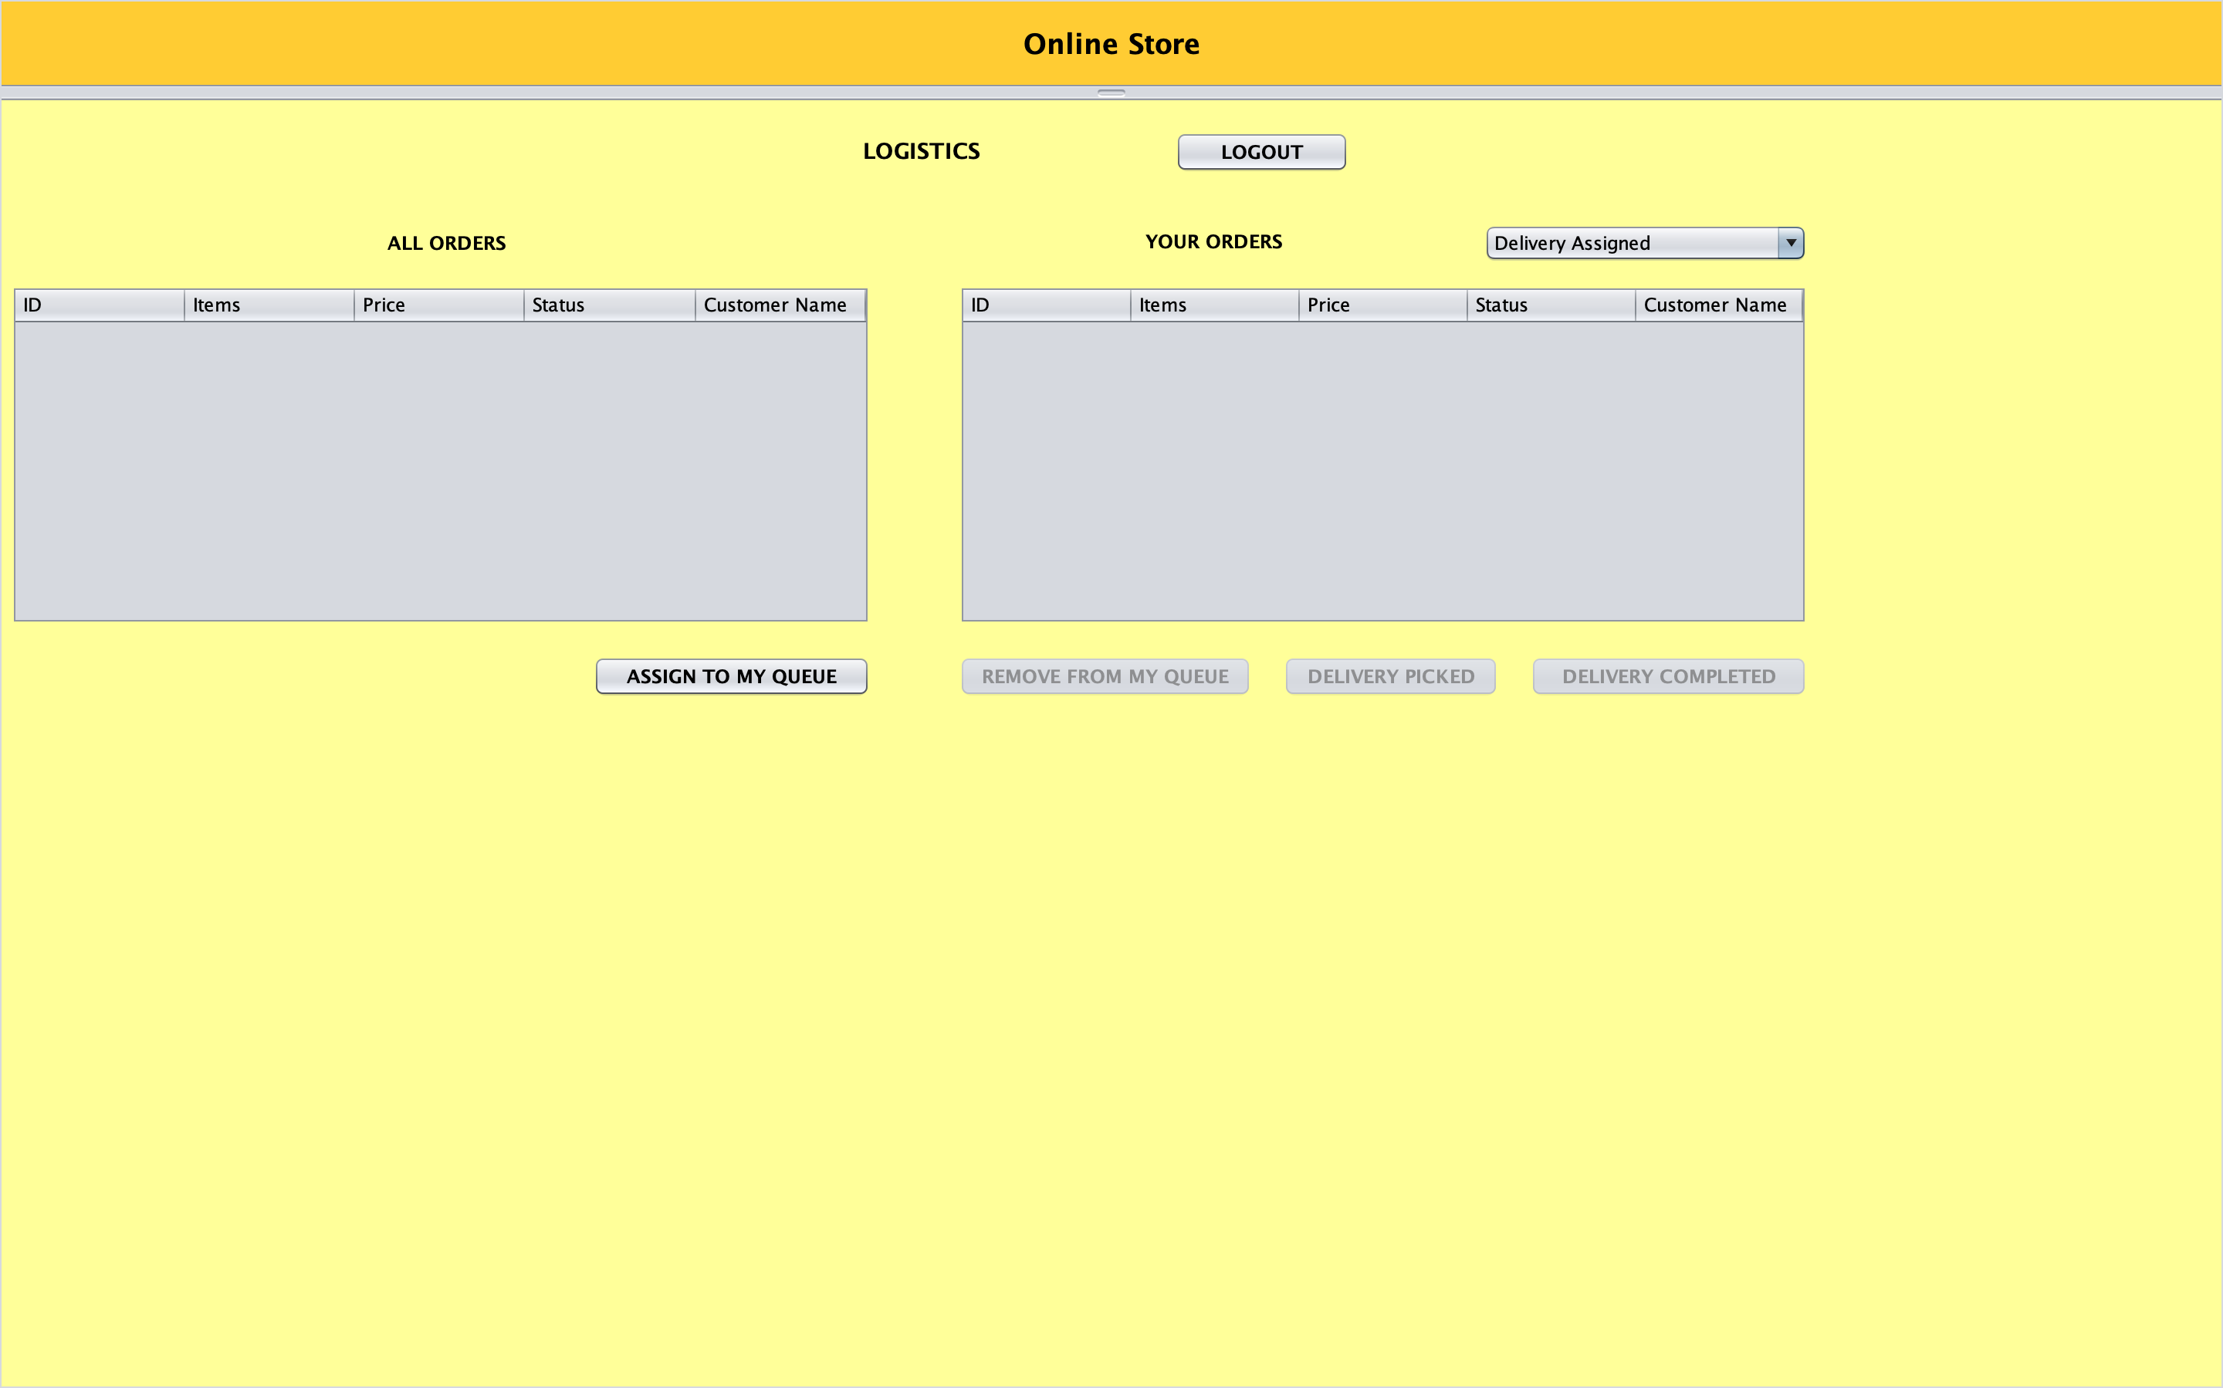
Logistics UI:

Slide 13
Learning Outcomes
Able to understand different Design patterns and MVC architecture along with different object-oriented principles.
Development of a GUI using Java Swing for an Online Store .
Handling different exceptions that could occur in the Backend part.
Understanding Java’s File Handling functionalities.
Understanding Entities and their relationship.

Slide 14
Future Enhancements
A more interactive UI can be developed by integrating frontend technologies such as HTML, CSS, JavaScript, React or Angular.
A Dashboard can be added for the Retailer to analyze the best selling products.
Hosting the application in Cloud platform .
A database can be Integrated for more efficient data handling.
Integrating ML models for suggesting products to the customers.

Slide 15
Name | Contribution
Sachin Vishaul Baskar | MVC architecture and modules for Customer Domain
Surjith Senthil kumar | Modules for Retailer and Orders Domain
Deepakraja Rajendran | Modules for Logistics Domain and its status.
Sai Srujan Penta | GUI for Logistics Domain using swing
Zhe Lin | GUI for Signup
Swamy Mudiga | GUI for Login
Uday Shankar Gattu | GUI for customer Domain using swing
Nishant Gada | GUI for Retailer and orders Domain using swing
Nirmit Rajkumar Shah | Integration of CSV file data using file handling
Individual Contributions

Slide 16
Thank You!

